Slide 1


PROJECT BASED LEARNING – CS10501A
Diabetes Prediction Model
DEPARTMENT OF COMPUTER SCIENCE AND ENGINEERING
SIKKIM MANIPAL INSTITUTE OF TECHNOLOGY
Under the Guidance of:
Mr. Dhruba Ray
Senior Faculty
BY:
SIDDHARTH SINGH – 202200141

Slide 2
SL.NO. | CONTENT | Pg No.
1. | ABSTRACT | 3
2. | INTRODUCTION | 4
3. | DATA PREPROCESSING | 5-6
4. | MODEL TRAINING AND PREDICTION | 7-11
5. | MODEL EVALUATION | 12
6. | CONCLUSION AND SIGNIFICANCE | 13

Slide 3

ABSTRACT
The Diabetes Prediction Model uses various machine learning algorithms to predict the likelihood of diabetes in individuals based on medical and demographic features. This documentation provides a comprehensive guide in understanding the model's purpose, data Preprocessing steps, model training and evaluation, and the significance of the results.

Slide 4

INTRODUCTION
· Objective of the Model: The Diabetes Prediction Model is designed to assess the likelihood of an individual having diabetes. This is done by analyzing various medical characteristics.
· Importance of Early Detection: Identifying diabetes early is crucial because it allows for timely intervention. Early detection means that individuals can start managing their condition before it progresses to more severe stages.
5

Slide 5
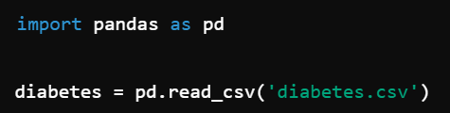
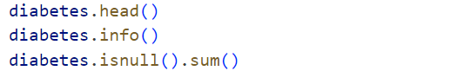
DATA PREPROCESSING
Loading the Dataset: The Dataset used is the Pima Indians Diabetes Dataset, which is loaded with the help of pandas.
Data Exploration: It helps us to explore the data to find missing values or to interpret something from that particular Dataset.
Handling Missing values: In our Dataset, there are no missing values. So, we do not need to perform operations to find missing values.
5

Slide 6
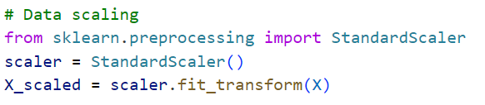
DATA PREPROCESSING
Feature and Target Variables
Data Scaling: To perform data scaling we use “StandardScaler”.
Splitting the Dataset: Splitting the Dataset into training and testing sets in the ratio 80:20.
5

Slide 7
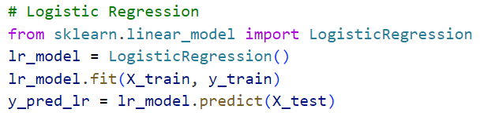
MODEL TRAINING AND PREDICTION
Logistic Regression : It is a type of supervised machine learning algorithm that is used for binary classification problems. It is binary (1/0 or Yes/No or True/False) depending on one or many independent variables (features).
Logistic Regression is used in classification not regression.
Key Concepts:
1.Logistic Function (Sigmoid Function): Transforms the linear combination of input features into a probability (a value between 0 and 1).
Decision Boundary: The threshold probability (usually 0.5) used to classify the input into one of the two classes.

Slide 8
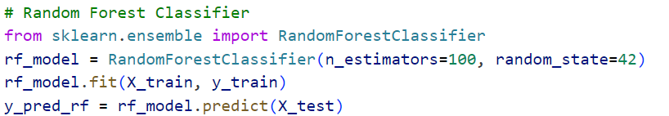
MODEL TRAINING AND PREDICTION
Random Forest Classifier: It is a sub type of ensemble learning where a large number of decision trees is built in the training phase. Bagging is also used together with random feature selection in which the conception of bootstrapping are integrated into the model to minimize over fitting.
Key Concepts:
1.Ensemble Method: Combines multiple models to improve performance.
2.Majority Voting: For classification, the class that gets the most votes from all the trees in the forest is chosen.

Slide 9
MODEL TRAINING AND PREDICTION
Hyper-parameters of Random Forest:
Some important hyper-parameters you can tune in a Random Forest model:
•n_estimators: The number of trees in the forest.
•max_depth: The maximum depth of the tree.
•min_samples_split: The minimum number of samples required to split an internal node.
•min_samples_leaf: The minimum number of samples required to be at a leaf node.
max_features: The number of features to consider when looking for the best split

Slide 10
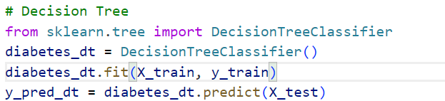
MODEL TRAINING AND PREDICTION
Decision Tree: It does this by dividing the data into subsets based on the value of the input features; this results in a tree structure where a node is a feature, a branch is a decision rule, and a leaf node is a consequence (class label or numeric value).
Key Concepts:
1.Root Node: The top node of the tree where the first decision is made.
2.Internal Nodes: Nodes where decisions are made based on features.
3.Leaf Nodes: Terminal nodes that provide the output (class label or value).
4.Splitting: The process of dividing a node into two or more sub-nodes.

Slide 11
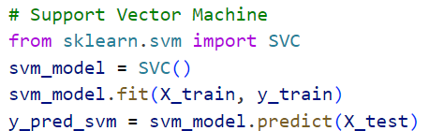
MODEL TRAINING AND PREDICTION
Support Vector Machine: It is a supervised learning method used for creating models for classification as well as regression analysis. One of its important characteristics is that it performs especially well on the data of high dimensions. SVM on the other hand seeks to find the best hyperplane that will bound the data well according to its classes.
Key Concepts:
1.Hyperplane: A decision boundary that separates different classes in the feature space.
2.Margin: The distance between the hyperplane and the nearest data points (support vectors). SVM aims to maximize this margin.

Slide 12
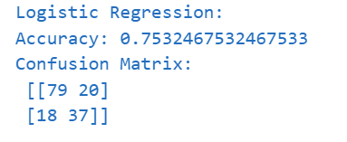
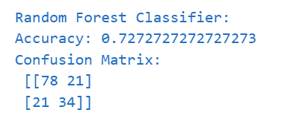
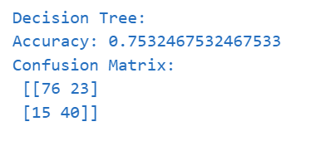
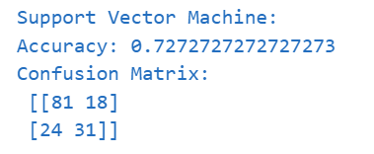
MODEL EVALUATION
Evaluating the model based on following parameters
Accuracy Score: The proportion of the number of true positive cases and false negative cases to the total number of cases; the efficiency of the model.
Confusion Matrix: A table that demonstrates the true positive, true negative, false positive and false negative predictions, giving detailed description or overall results of the model.
Mean Squared Error (MSE): The squared sum of the differences between the predicted and actual values divided by the number of values, used to determine the accuracy of a regression line.

Slide 13


Slide 14


Slide 15
CONCLUSION
The Diabetes Prediction Model utilizes advanced artificial neural networks along with Support Vector Machines, Decision Trees, Random Forests, and Logistic Regression to accurately estimate an individual’s risk of developing diabetes based on extensive medical data. This sophisticated approach enhances the precision of predictions, aiding in timely diagnosis and intervention.
By predicting the likelihood of diabetes, the model facilitates early diagnosis and proper medical intervention, potentially preventing the severe complications associated with undiagnosed diabetes. The ongoing assessment and comparison with other methods ensure the model's reliability and relevance in assisting healthcare professionals to provide personalized care.

Slide 16
THANK YOU

